Slide 1
St10278399
Claims app

Slide 2
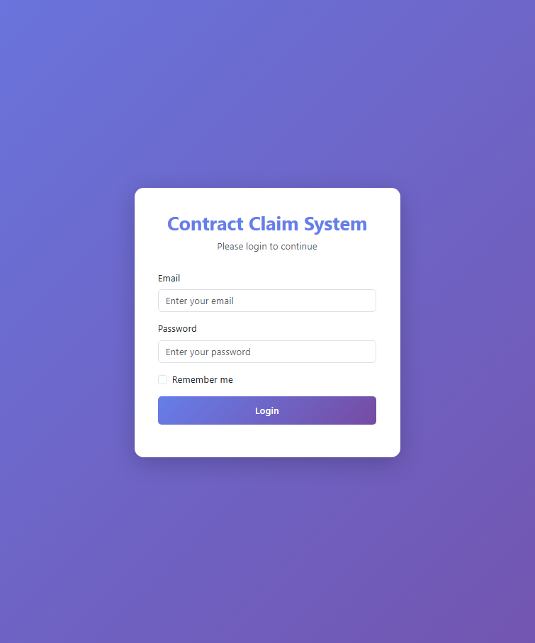
LOGIN DESIGN
The system displays spaces for email and password
There is no option to choose a role in the login page because it can validate the email and password and redirect the user to the correct dashboard.
The system no longer allows registration from the login page.
This ensures secure logins that can only be provided by HR.

Slide 3

Dashboard views

Slide 4
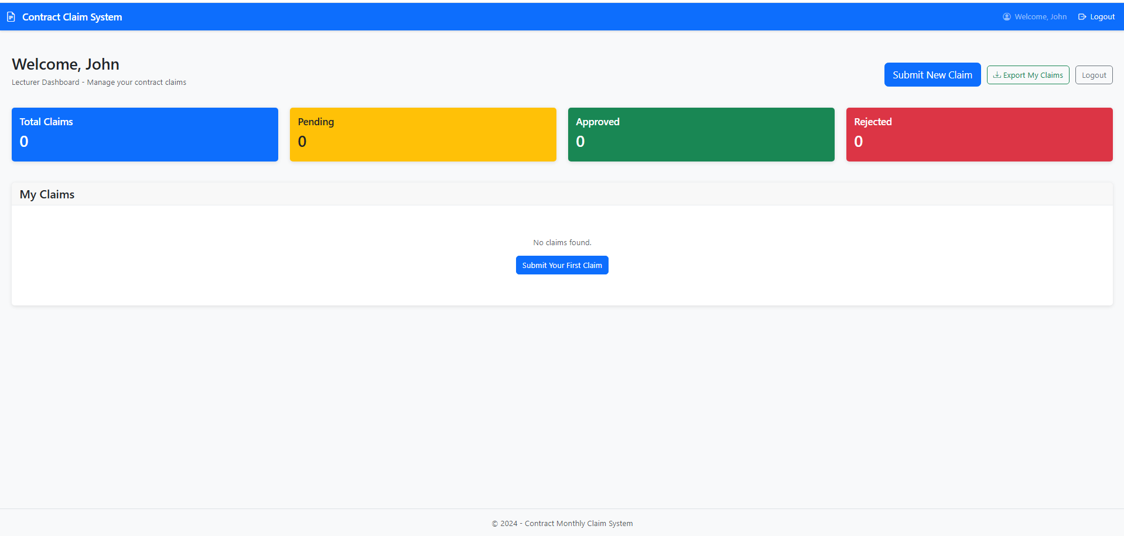
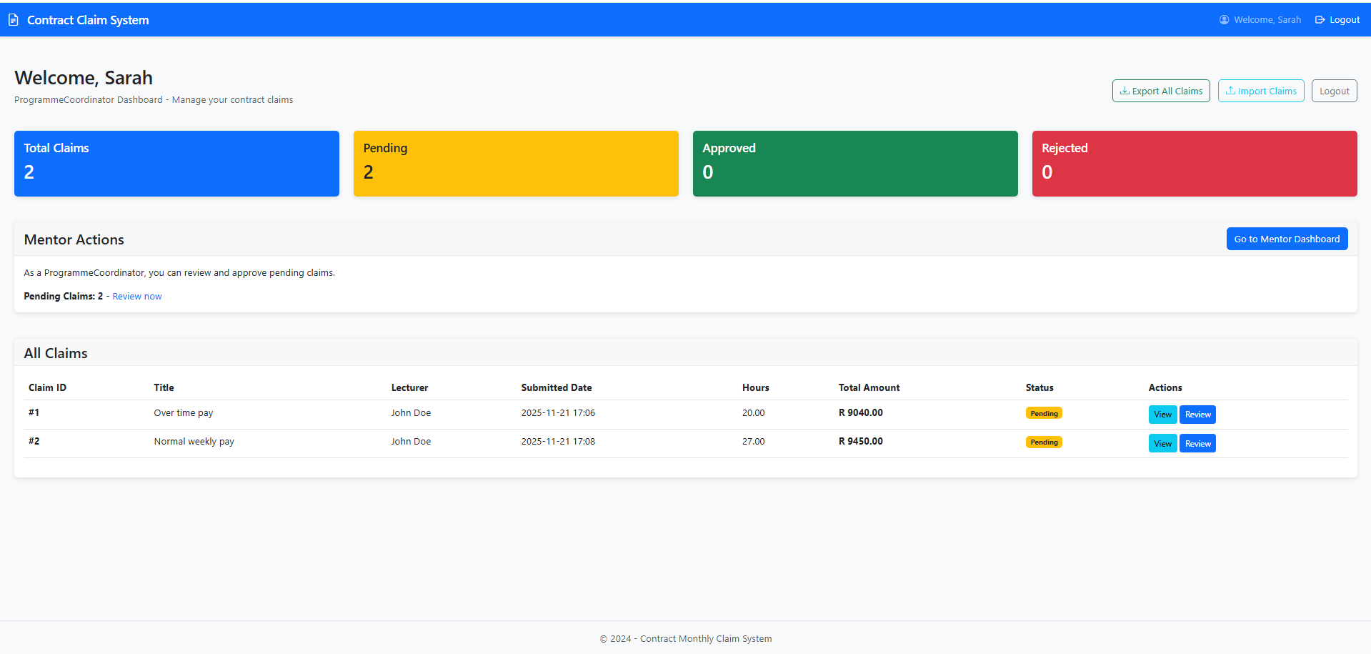
Simplification of dashboard views
The Dashboards were designed to be simple and colorful, making them easy to navigate.
The system displays the previously submitted claims.

Slide 5
Creating a New CLAIM

Slide 6
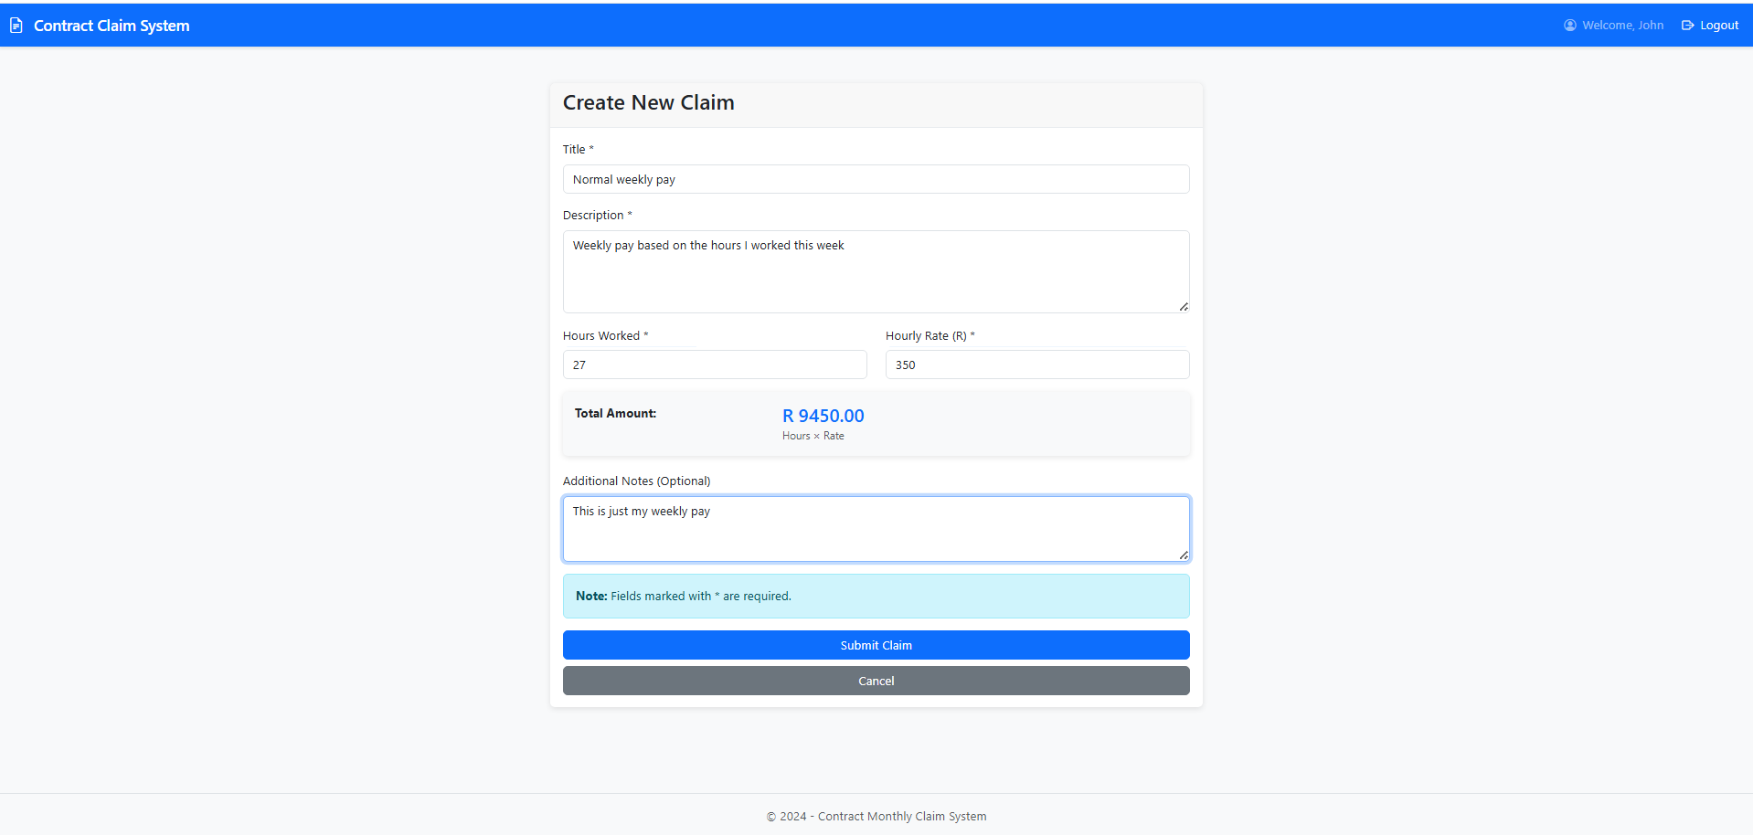
NEW CLAIM
The page for creating a new claim, this page allows a user to enter the title of their claim, whether it is monthly wages or over time owed.
Description of the claim.
Hours worked and Hourly Rate, which multiply and give real-time total before submitting the claim.

Slide 7
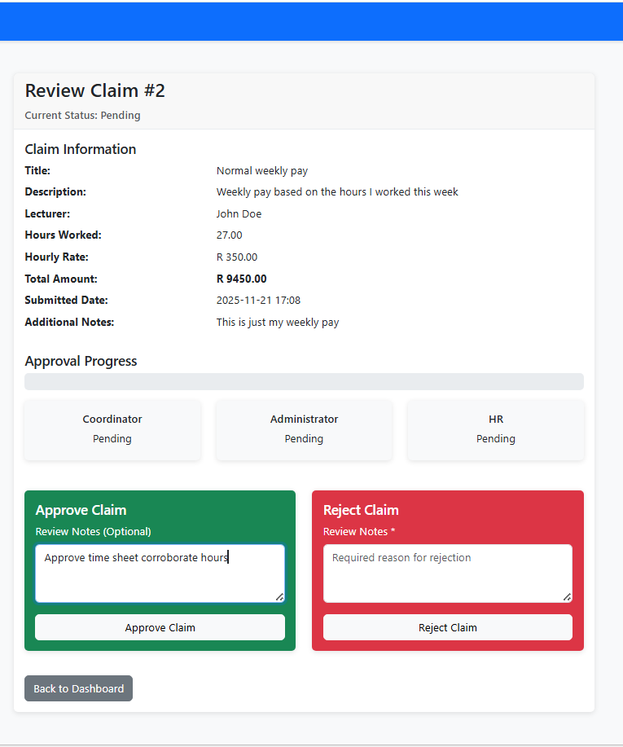
CLAIM REVIEW
  Review submitted claims
  Final approval or rejection
  Reject claims if information is inconsistent
  A newly submitted claim is first reviewed by the Coordinator
  Administrators ensure accuracy and compliance before HR sees claims
System updates claim status for visibility in the HR dashboard

Slide 8
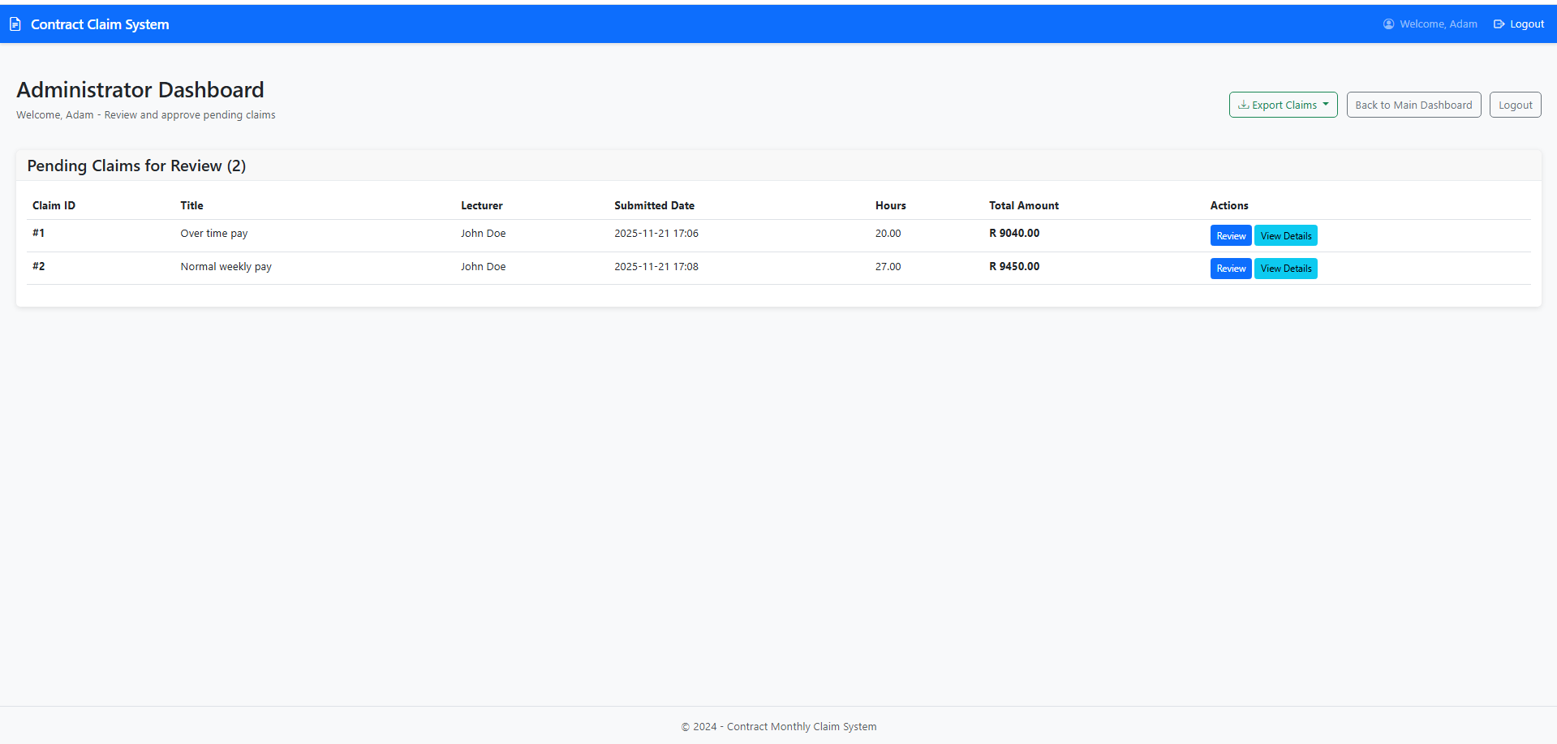
LIST OF CLAIMS
If a claim is approved by the Coordinator, it can then be seen in the Administrator dashboard.
But if the claim is rejected by either the Coordinator or Administrator, it can not be seen in the HR dashboard

Slide 9
HR PERSONNEL

Slide 10
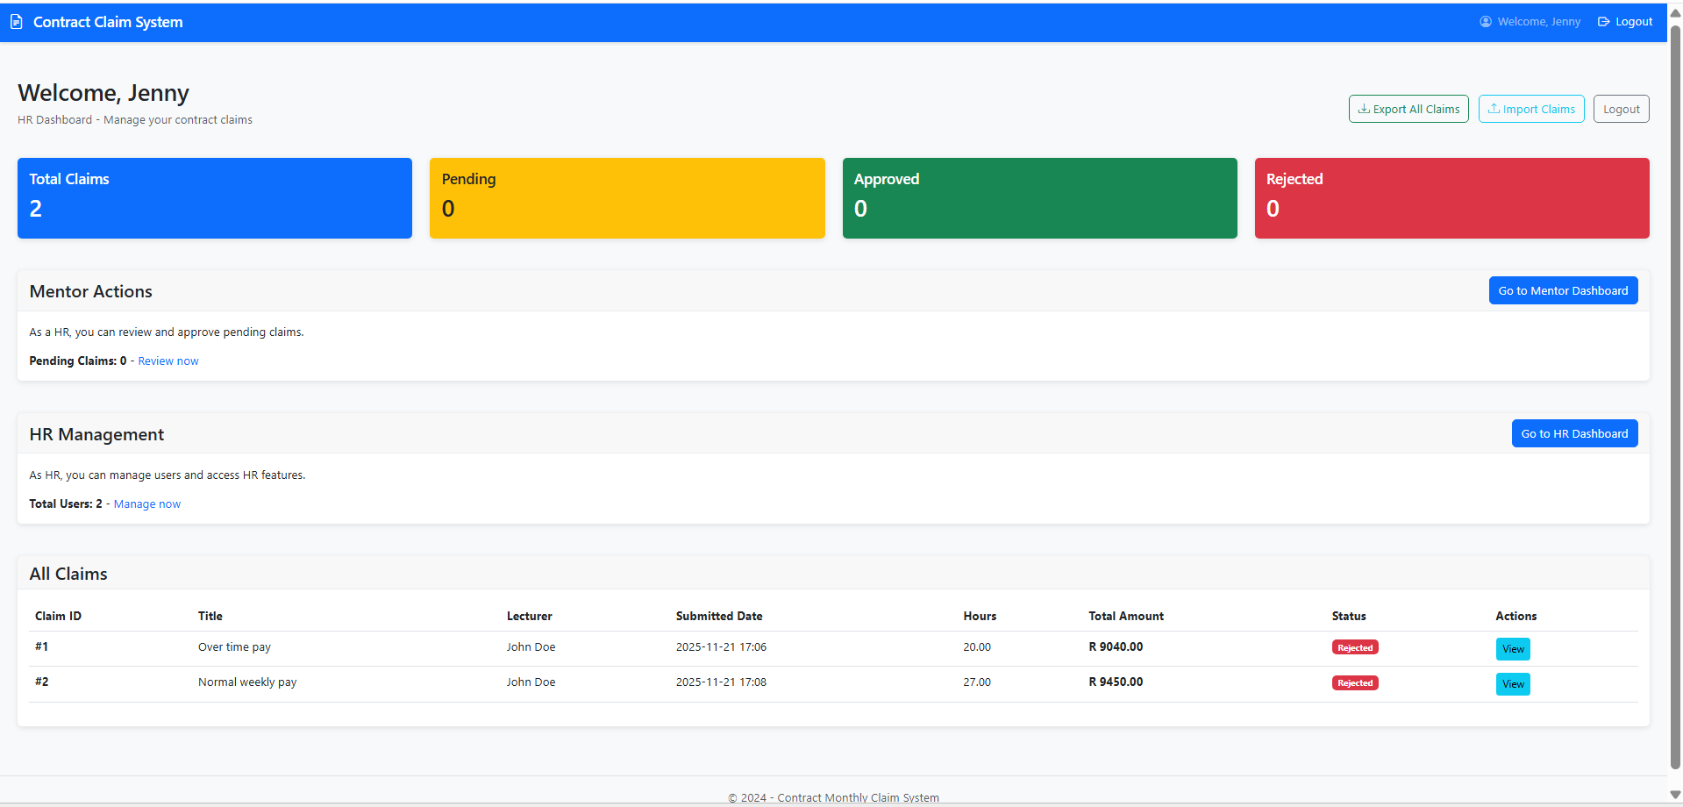
HR DASHBOARD

Slide 11
WHAT THE HR DASHBOARD DOES
  HR cannot see claim details until the admin approves/rejects
  Can access the feature to manage users
  HR can see the total number of claims
  Can approve remaining claims if applicable

Slide 12
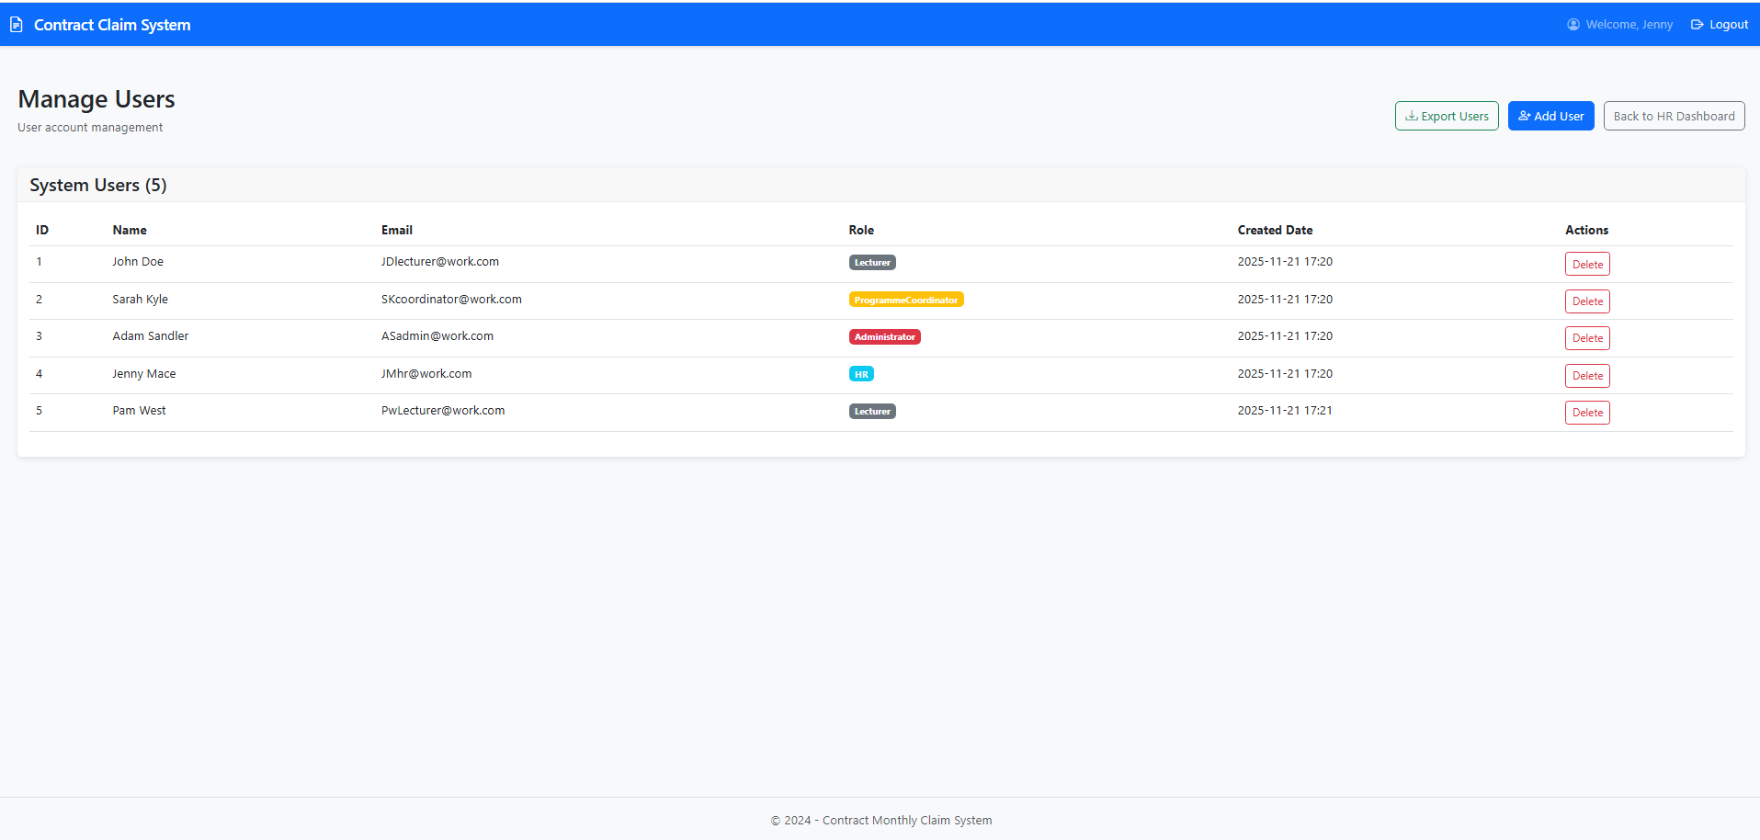
User Management
  This is where a list of created users will appear with the date the login details were created, and their roles.
  HR personnel can choose to create a new User or to delete an existing one.

Slide 13
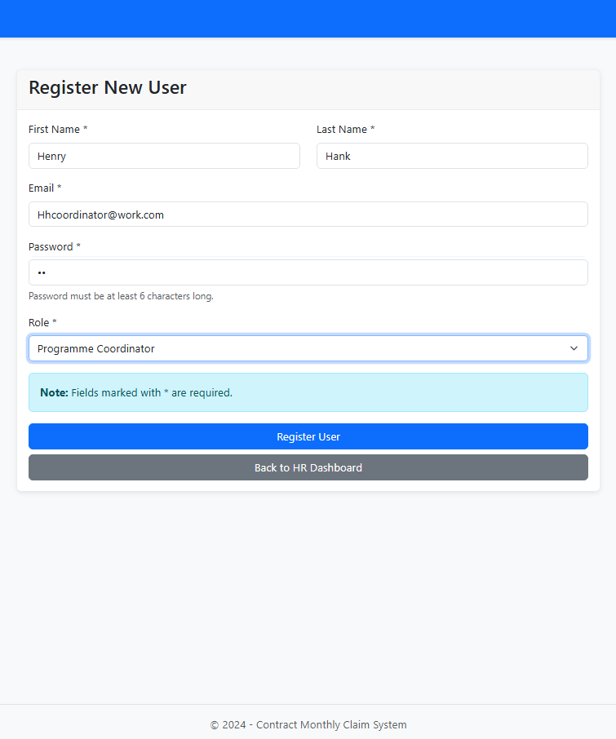
USER CREATION
  Here is where HR personnel can register a new user
  Assign roles such as Coordinator, Administrator, lecturer, or create new HR logins
  A New User is added to the system immediately after registration

Slide 14
Summary
This PowerPoint illustrates the entire workflow from the very first claim submission to the final approval, and highlights how streamlined and user-friendly the system is at every stage, while demonstrating efficiency and simplicity of the claims application. It demonstrates how certain features and permissions are given to each position according to its seniority, which helps to ensure strong, accurate claim processing and transparency that guarantees claims are handled consistently and effectively.

